Slide 1
.NET FRAMEWORK

Slide 2
INTRODUCTION TO .NET
.NET is a framework to develop software applications. It is designed and developed by Microsoft and the first beta version released in 2000.
It is used to develop applications for web, Windows, phone. Moreover, it provides a broad range of functionalities and support.
This framework provides various services like memory management, networking, security, memory management, and type-safety.

Slide 3
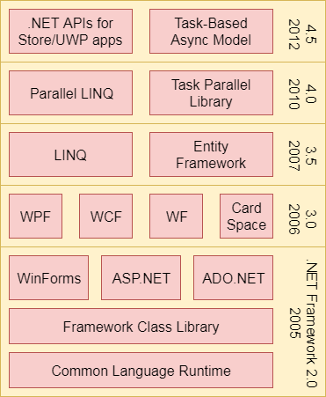
Four Main Components:
Common Language Runtime (CLR)
Framework Class Library (FCL),
Core Languages (WinForms, ASP.NET, and ADO.NET), and
Other Modules (WCF, WPF, WF, Card Space, LINQ, Entity Framework, Parallel LINQ, Task Parallel Library, etc.)

Slide 4
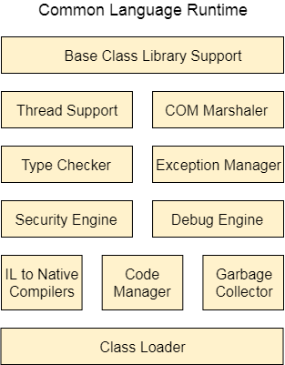
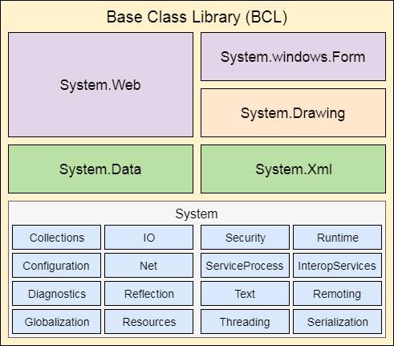
CLR (Common Language Runtime) &FCL (Framework Class Library)
It is a program execution engine that loads and executes the program.
It converts the program into native code. It acts as an interface between the framework and operating system
It is a standard library that is a collection of thousands of classes and used to build an application. The BCL (Base Class Library) is the core of the FCL and provides basic functionalities.

Slide 5
WinForms
Windows Forms is a smart client technology for the .NET Framework, a set of managed libraries that simplify common application tasks such as reading and writing to the file system.
ASP.NET
ASP.NET is a web framework designed and developed by Microsoft. It is used to develop websites, web applications, and web services.
ADO.NET
ADO.NET is a module of .Net Framework, which is used to establish a connection between application and data sources.
WPF (Windows Presentation Foundation)
Windows Presentation Foundation (WPF) is a graphical subsystem by Microsoft for rendering user interfaces in Windows-based applications.
WCF (Windows Communication Foundation)
It is a framework for building service-oriented applications. Using WCF, you can send data as asynchronous messages from one service endpoint to another.
WF (Workflow Foundation)
Windows Workflow Foundation (WF) is a Microsoft technology that provides an API, an in-process workflow engine, and a rehostable designer to implement long-running processes as workflows within .NET applications.
LINQ (Language Integrated Query)
It is a query language, introduced in .NET 3.5 framework. It is used to make the query for data sources with C# or Visual Basics programming languages.

Slide 6
.NET Common Language Runtime (CLR)
.NET CLR is a run-time environment that manages and executes the code written in any .NET programming language.
It converts code into native code which further can be executed by the CPU.
.NET version | CLR version
1.0 | 1.0
1.1 | 1.1
2.0 | 2.0
3.0 | 2.0
3.5 | 2.0
4 | 4
4.5 | 4
4.6 | 4
4.6 | 4

Slide 7

..NET Framework Class Library
.NET Framework Class Library is the collection of classes, namespaces, interfaces and value types that are used for .NET applications.
It contains thousands of classes that supports the following functions.
Base and user-defined data types
Support for exceptions handling
input/output and stream operations
Communications with the underlying system

Slide 8

NET Framework Base Class Library
.NET Base Class Library is the sub part of the Framework that provides library support to Common Language Runtime to work properly. It includes the System namespace and core types of the .NET framework.

Slide 9
.NET Framework Class Library Namespaces
Namespaces | Description
System | It includes all common datatypes, string values, arrays and methods for data conversion.
System.Data, System.Data.Common, System.Data.OleDb, System.Data.SqlClient, System.Data.SqlTypes | These are used to access a database, perform commands on a database and retrieve database.
System.IO, System.DirectoryServices, System.IO.IsolatedStorage | These are used to access, read and write files.

Slide 10

Thank you

